Slide 1
SESSION 1
HTML, CSS AND JAVASCRIPT

Slide 2


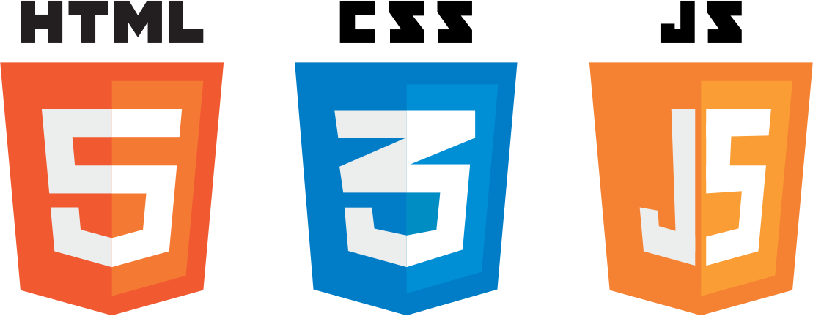
Web Development
HTML : Used To Define the Content of the Webpage
CSS : Used To Define the Style of the Content
JavaScript : Used To add functionality to the Content

Slide 3





Web Development

Slide 5
HTML
Hyper Text Markup Language
HTML is a markup Language that web-developers use to structure and describe the content of a webpage.
HTML consists of elements that describe different types of content : paragraphs , links, headings, images, video, etc.
Web browsers understand HTML and render HTML code as websites

Slide 6
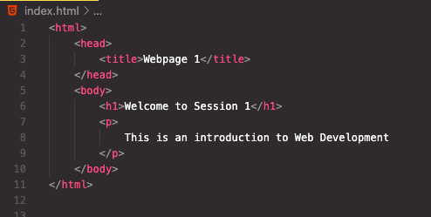
Structure of HTML
HTML
Head Section
Elements
Body Section

Slide 7
Anatomy of a HTML Element
<p> HTML is a Markup Language </p>
Element
Opening Tag : Name of the element wrapped in < and >
Content : Content of the element, in
this example text. But it might be
another element (child element). Some elements have no content (e.g. <img>)
Closing Tag : Same as opening tag, but with a / . When Element has no content , its omitted.

Slide 8
HTML Attributes
All HTML elements can have attributes
Attributes provide additional information about elements
Examples : href , src , name, class, id , etc
Opening Tag
<p class=“title-text”> Welcome to Session 1 </p>
Attribute

Slide 9
HTML Attributes
Hyperlink Reference
Relative Source of Image
Alternate Text

Slide 10
HTML Tags
<h1> - <h6> : Heading Tags
<div> : Division Tag
<p> : Paragraph Tag
<img> : Image Tag
<a> : Anchor Tag
<table> : Table Tag
<ul> <ol> : List Tags
<form> : Form Tag

Slide 11
Challenge
Question 1 : HTML is used for styling Webpages, True or False
Question 2 : What does HTML stand for ?
Question 3 : How many parts can any element be divided into?
Question 4 : All Elements need a closing tag, True or False.
Question 5 : Does Order of Elements matter in HTML ?

Slide 13
CSS
Cascading Style Sheet
CSS describes how HTML elements are to be displayed on screen or in other media
It can control the layout of multiple web pages all at once

Slide 14

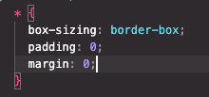
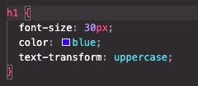
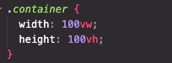
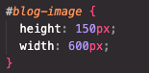
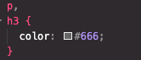
Selectors
Universal Selector : *
Element : <tagname>
Class : .classname
Id : #id-name
Grouping : Element , Element

Slide 15
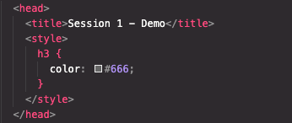
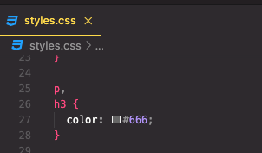
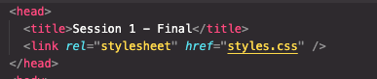
How to Use CSS
Inline CSS
Internal CSS
External CSS
styles.css
index.html

Slide 16
CSS – Box Model
Margin
Border
Padding
Content

Slide 17
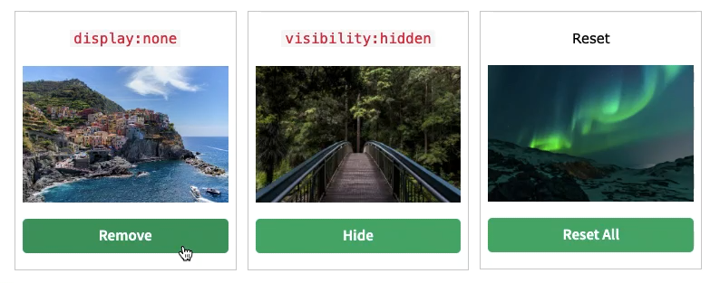
Display
None : Hides the element completely
Inline - Takes only the required space. Ex : span , a , img, etc.
Block – Takes the complete width of the page. Ex: div, p , form, etc.
Flex – Flexible way of aligning content.
Grid – Very Similar to Flex.

Slide 18
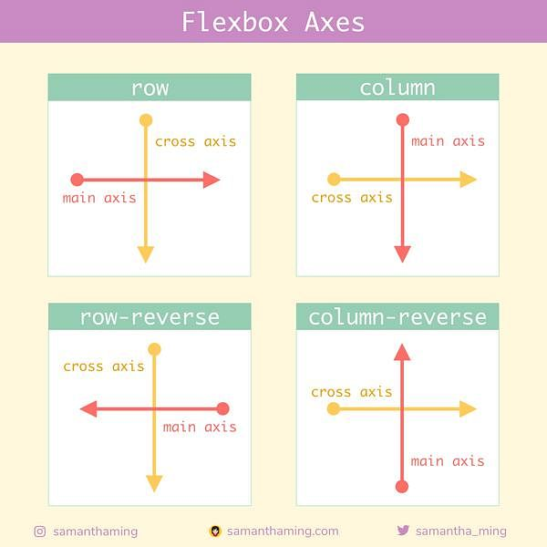
Flex Layout
Flex is a one-dimensional layout method for laying out items in rows and columns
Parent is the Flex Container & children are the Flex Items.
By default, we have the Row Direction

Slide 19
Grid Layout
Grid layout is used for manipulation in two dimensions
It uses rows and columns to achieve this.
The gaps between each row and column is called gutters.

Slide 20
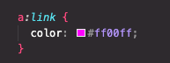
Psuedo Classes
Uses to define special states of Elements
Syntax : selector:pseudo-class { property: value; }
Examples - :hover, :focus, :active, :visited, :nth-child(1), :last-child , etc

Slide 21
Challenge
Question 1 : What is the the universal Selector ?
Question 2 : What is priority of Internal CSS ?
Question 3 : Can a CSS file be used in multiple HTML Pages?
Question 4 : Can we apply the same styles to multiple elements ?
Note : Yes / No or True/ False answers need Justification as well

Slide 22


Slide 23
Javascript
JavaScript is a cross-platform, object-oriented scripting language used to make webpages interactive
E.g., having complex animations, clickable buttons, popup menus, etc.
Core Javascript can be run/executed with a Web Browser.

Slide 24



Frontend
Backend
Mobile Applications
Native Desktop Application

Slide 25
Versions
ECMAScript versions have been abbreviated to ES1 (1997), ES2 (1998), ES3 (1999), ES5 (2009), and ES6 (2015).
Since 2016, versions are named by year (ECMAScript 2016, 2017, 2018, 2019, 2020).

Slide 26
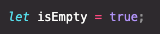
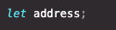
Datatypes
Number – Floating point Numbers
String – Sequence of characters
Boolean – Logical Type , either true or false
Undefined – Value taken by a variable when its not defined
Null – Empty Variable
Symbol (ES2015) – Value that is unique
BigInt – Values larger than Number can hold

Slide 27
Variables
Var : Used before ES6
Const : Declares a constant , Immutable Variable
Let : Declares a mutable variable.

Slide 28
Operators
Arithmetic Operators (+, - , / , *)
Comparison Operators (> , < , >= , <= )
Logical Operators ( &&, || , ! )
Assignment Operators ( = , += , -= , ++ , -- )

Slide 29
Conditional Statements (if/else)
Executes code if the condition is true or satisfied or not.
Syntax :
if(condition){
statements
} else {
statement
}

Slide 30
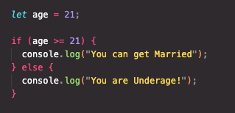
Challenge

Slide 31
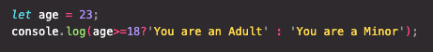
Conditional Statements : Ternary Operator
Syntax :
Condition ? Truthy Operation : Falsy Operation

Slide 32
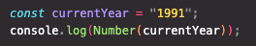
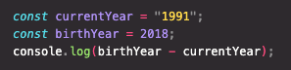
Type Conversion and Coercion
Type Conversion – When datatype is manually converted from one type to another.
Type Coercion – The conversion that takes place implicitly.

Slide 33
Truthy and Falsy Values
False
Undefined
Null
0
‘’
NaN

Slide 34
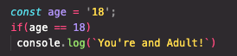
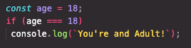
Equality Operators
==
===
Loose Check
Strict Check
Does Type Coercion
Does not do Type Coercion

Slide 35
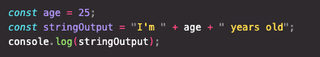
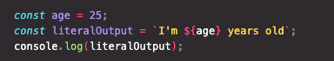
Template Literals
Used to write a string in a more normal way where we can insert values into it from variables.
Syntax : `text ${variable/operation}`

Slide 36
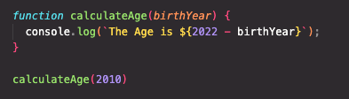
Functions
A function is simply reusable piece of code.
Syntax : function functionName (arguments){
Code to Execute
}
Callback or Function Call : functionName(Values)

Slide 37
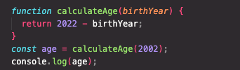
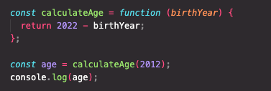
Function Declaration vs. Expression
Function Expression uses an anonymous function and stores it in a variable , which can be used to perform an operation.
Function Declaration
Function Expression

Slide 38
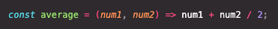
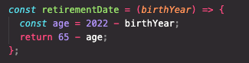
Arrow Function
Simplified way of writing a function.
Arrow
Return Statement
Input Parameter

Slide 39
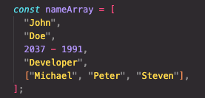
Arrays
An array is a special variable, which can hold more than one value:

Slide 40
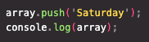
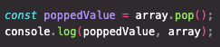
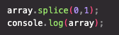
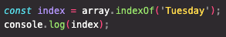
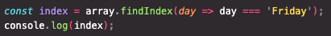
Array Functions
push() : Allows you to add a new item to an existing array
pop() : Retrieves the last value from array.
splice() : Allows you to add or delete items in the array.
indexOf() : Returns the first index , where value is found.
findIndex() : Returns the first index that satisfies the condition.
filter() : Creates new array with elements that satisfy the function condition.

Slide 41
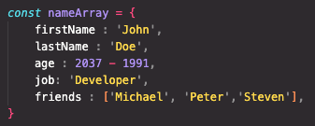
Objects
Objects are JavaScript Variables that contain more than one value .
The values are written as key:value pairs (name and value separated by a colon).

Slide 42
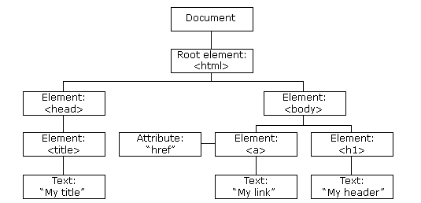
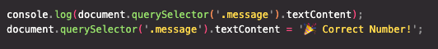
DOM Manipulation
Document Object Model
DOM is not a part of JavaScript
Part of Web API – can be used by JS
Can Change Text, HTML Attributes
& even CSS Styles

Slide 43
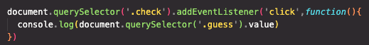
Event Handling
An event is nothing but some action that happens on the page
Eg : Mouse Click, Mouse Hover, Key Up / Down etc
Selector
Event Handler Function
Listener
Event

Slide 44
That’s it Folks!
Thank You

